Slide 1
Advanced algorithm project
Multiplication of large integers using ( Divide and conquer )
Name :- Mohannad Mohamed Aboyoussef
ID :- 203391

Slide 2
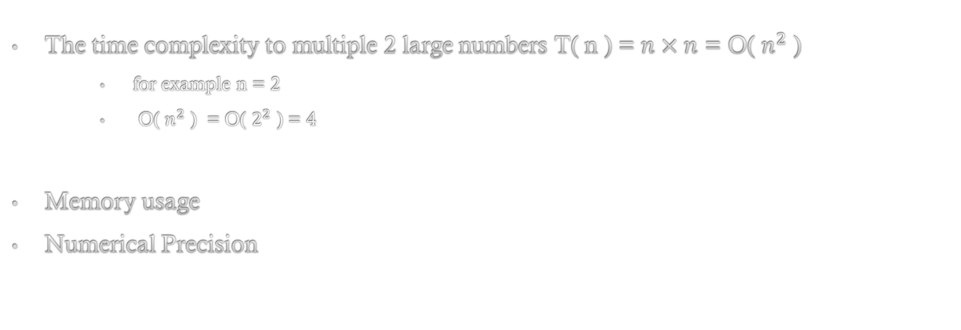
The problem
The time complexity to multiple 2 large numbers T( n ) = $n×n$ = O( $n^{2}$ )
for example n = 2
O( $n^{2}$ ) = O( $2^{2}$ ) = 4
Memory usage
Numerical Precision

Slide 3
The Strategy
Divide and conquer strategy
Divide
Conquer
Combine

Slide 4
The algorithm
Combine
Combine the solutions of the sub-problems to obtain the solution to the original problem. This step involves aggregating the results of the sub-problems in a way that ensures the correct solution to the overall problem.
Divide
Break the main problem into smaller, more manageable sub-problems. This is often done by dividing the input data or problem space into two or more parts. Each sub-problem should ideally be of the same type as the original problem but smaller in size
a, b = divmod(x, 10**n2)
c, d = divmod(y, 10**n2)
Conquer
Solve the sub-problems recursively. If the sub-problems are small enough, solve them directly. Otherwise, apply the same divide-and-conquer strategy to further break them down into even smaller sub-problems. Continue this process until the sub-problems become simple enough to be solved directly.
result =ac*10**(2*n2)+ad_bc*10**n2+bd

Slide 5
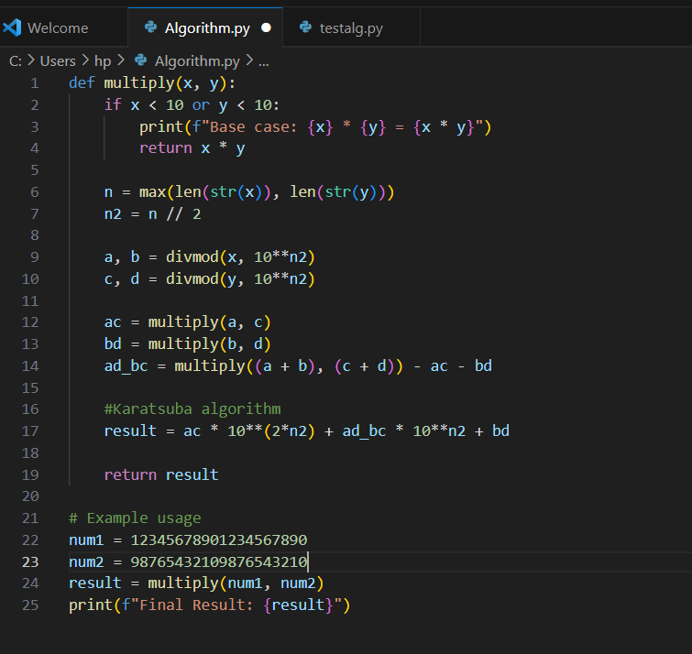
THE IMPLEMENTATION

Slide 6
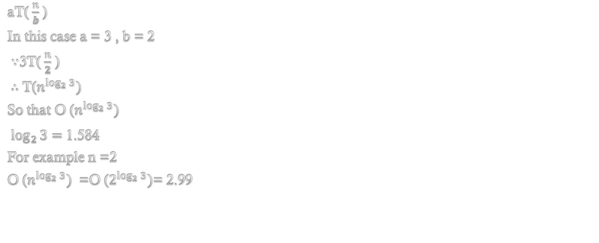
The Analysis
aT($\frac{n}{b}$ )
In this case a = 3 , b = 2
$∵$3T($\frac{n}{2}$ )
$∴$ T($n^{\log_{2}{3}})$
So that O ($n^{\log_{2}{3}})$
$\log_{2}{3}=$ 1.584
For example n =2
O ($n^{\log_{2}{3}})$ =O ($2^{\log_{2}{3}})$= 2.99

